Slide 1
Being Visible
Leap into Leadership
Nina mcConigley

Slide 2
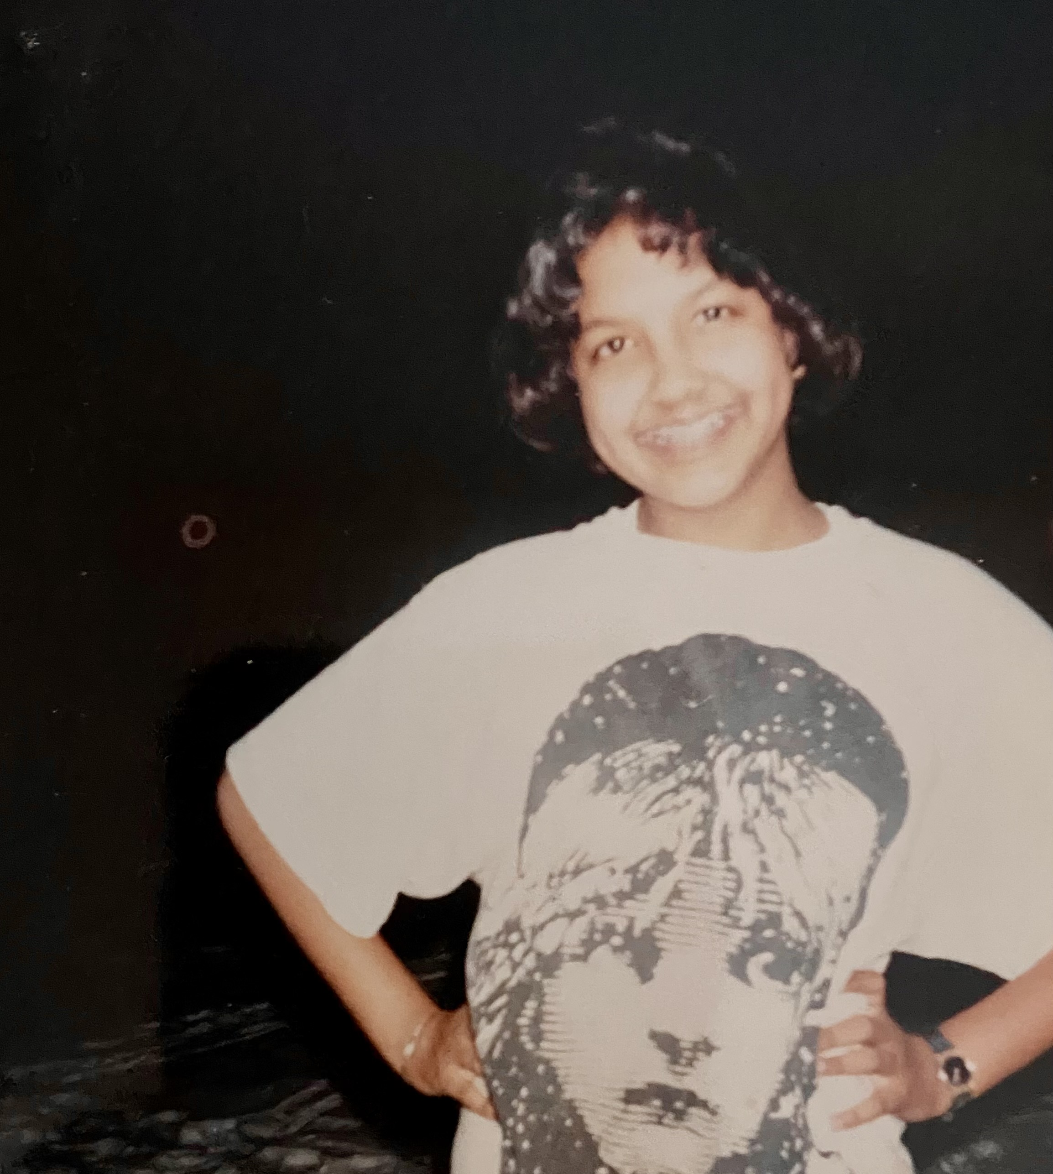
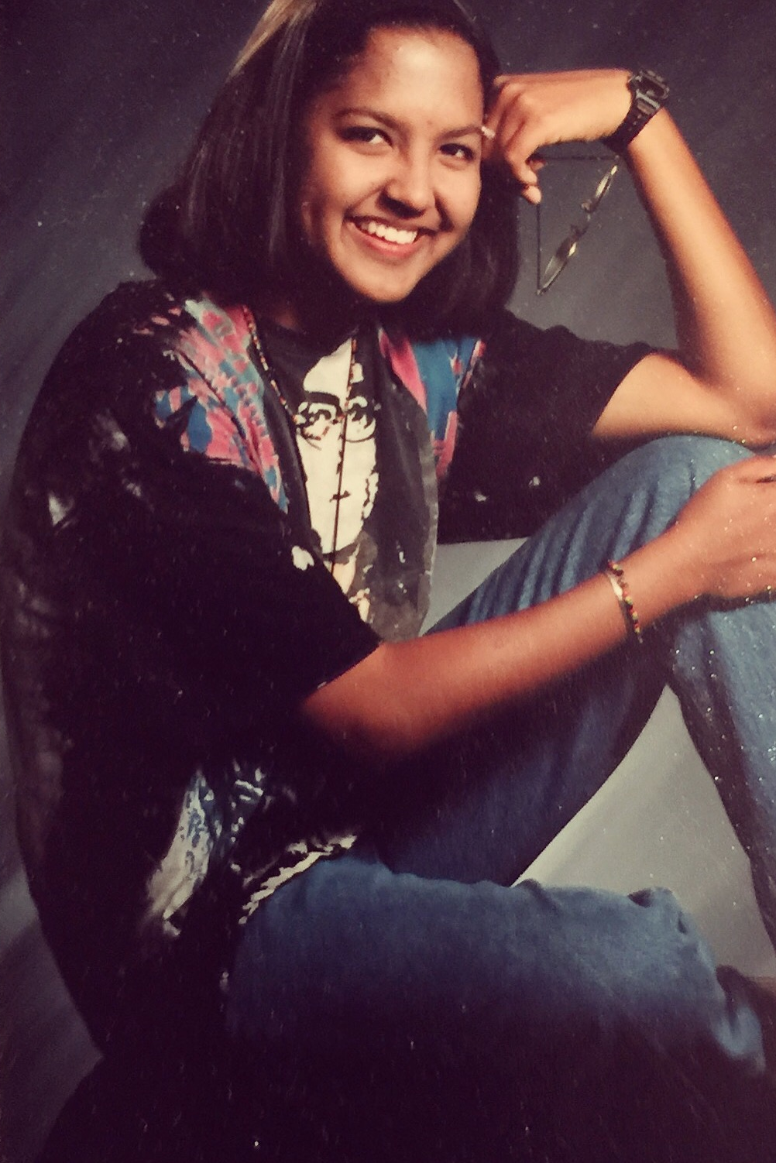
Me in High School

Slide 3
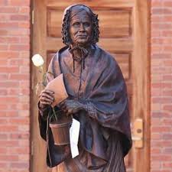
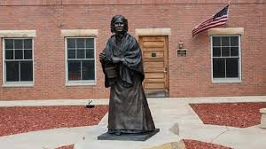
Louisa Swain

Slide 4
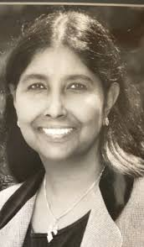
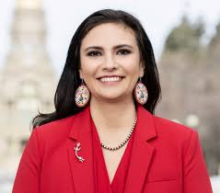
Nimi McConigley and
Affie Ellis

Slide 5
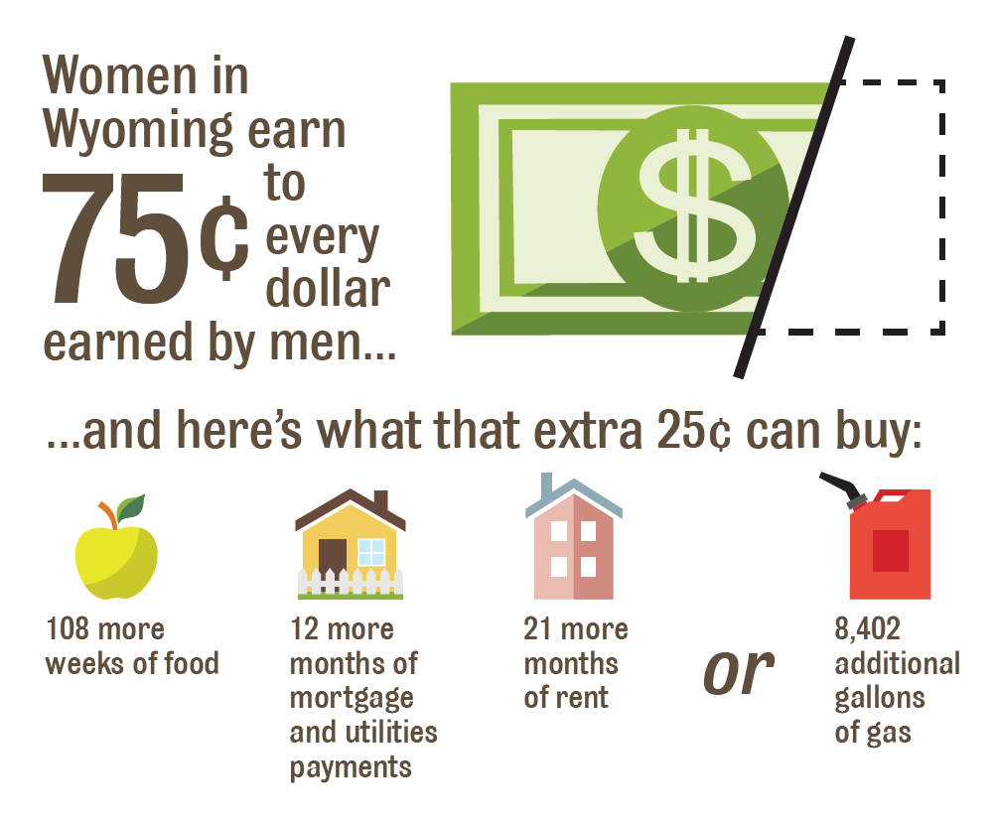
The Wage Gap in Wyoming in 2022: How Gender, Race and Ethnicity Affect Pay Equity:
The wage gap between men and women in Wyoming is $0.25. In other words, women make $0.75 for every $1.00 men make in Wyoming. According to the report, Wyoming’s wage gap remains the largest or nearly largest in the nation.
Source: from The Wyoming Women’s Foundation

Slide 6
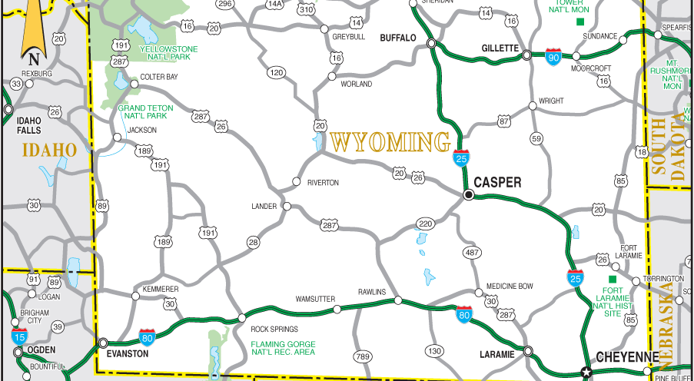
Casper, Wyoming

Slide 7


Eastridge Mall

Slide 8

Garden Creek

Slide 9
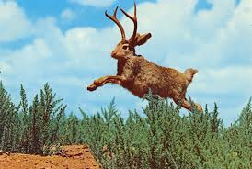
The Jackalope

Slide 10


Angel

Slide 11
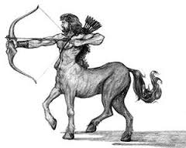

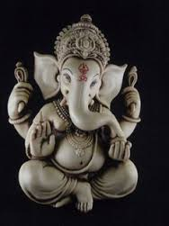
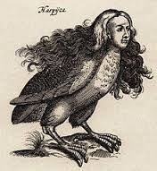

Mixed Creatures

Slide 12
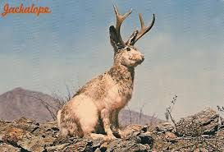

Slide 13
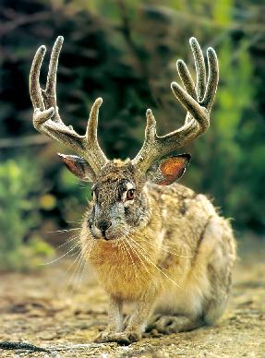

Slide 14
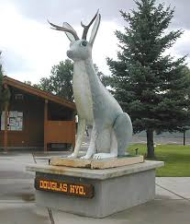

Slide 15
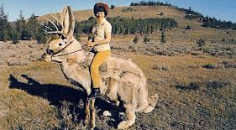

Slide 16
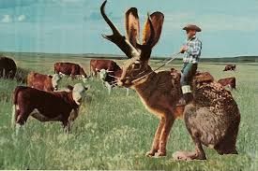

Slide 17
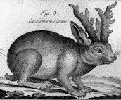

Slide 18
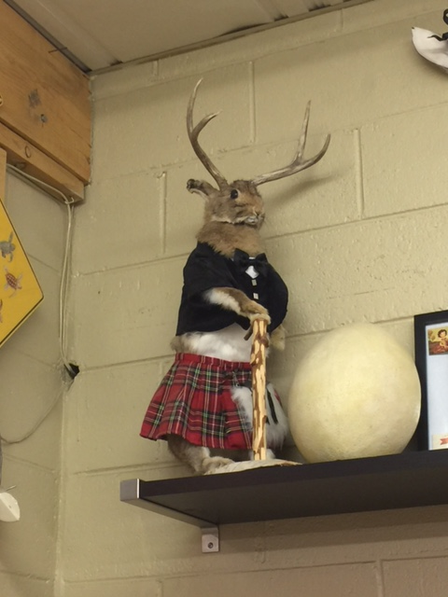

Slide 19
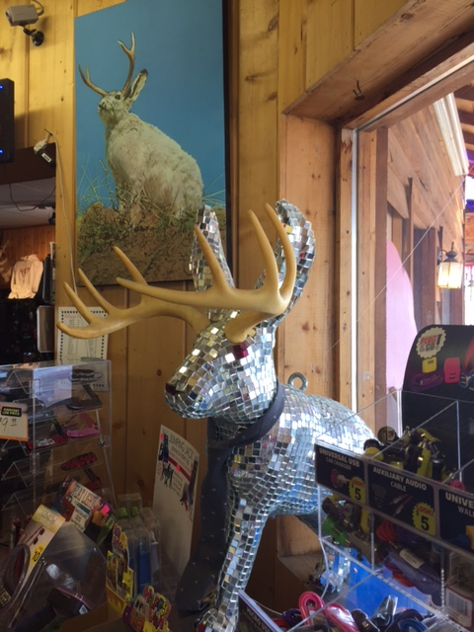

Slide 20
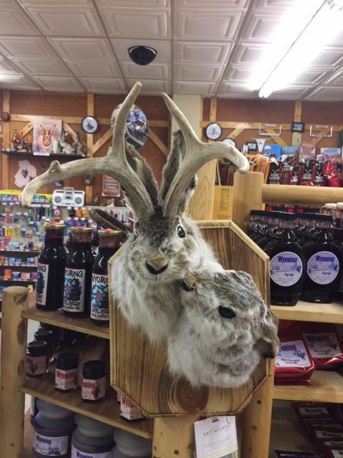

Slide 21
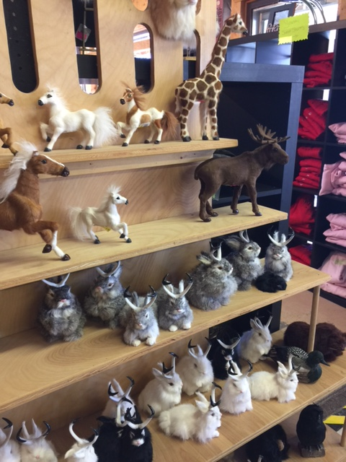

Slide 22
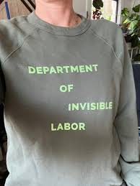
Department of Invisible Labor

Slide 23
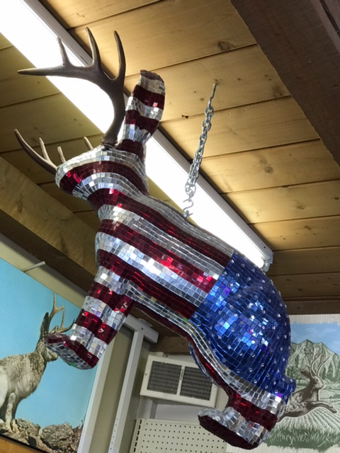
Shine Like No Other, and Leap

