Slide 1
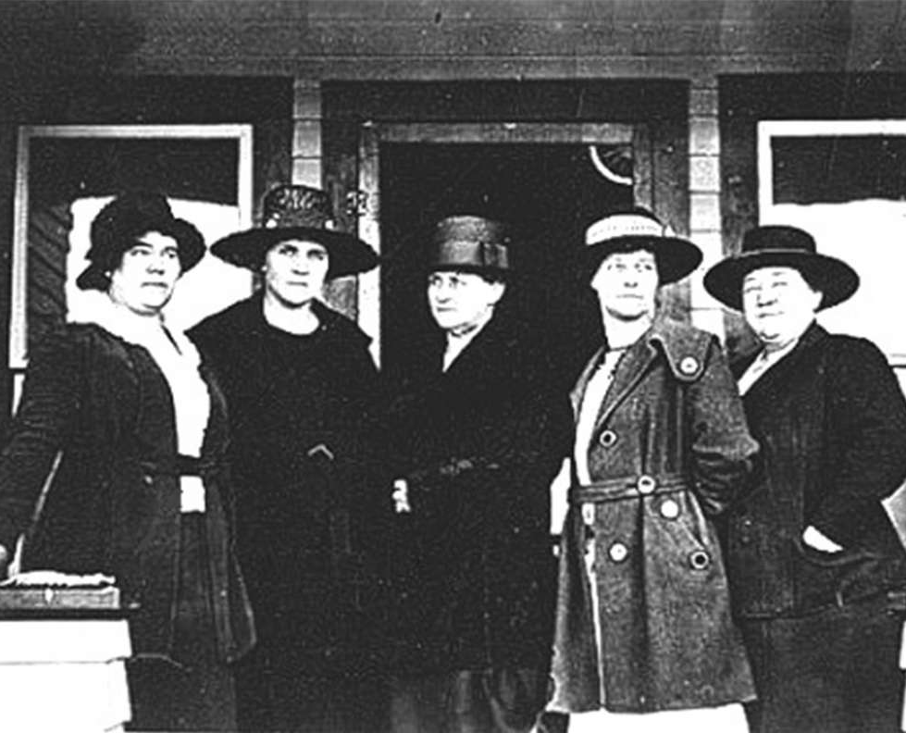

Wyoming Women’s Foundation Mission:
Economic Self-Sufficiency for Women & Opportunities for Girls
From Bills to Budgets:
Advocating for Wyoming Women & Girls
Micah Richardson
Associate Director of Policy
At the Wyoming Community Foundation

Slide 2

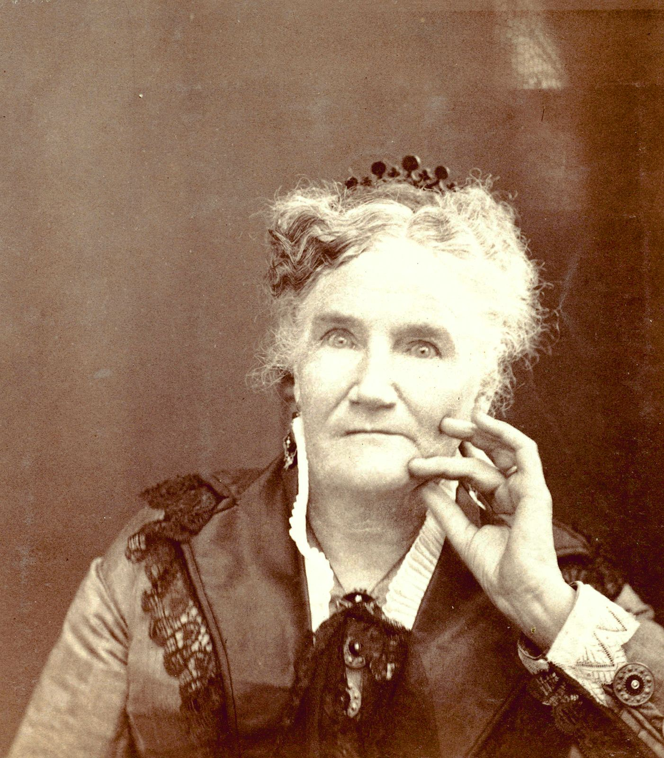
Why are you here today?
What is one word you'd use to describe what's happening with our legislature/state government?

Slide 3
Why Is Advocacy Important?
Women weren't able to get a bank account or have a credit card of their own until 1974.
A bill was filed this year that would no longer allow people to use their Medicaid and Medicare card as and ID to vote.
Funding to support maternal health will be impacted during this legislative session.
Notes:
Education:
1. Girls graduate from high school.
2. Women can access and afford post-secondary or continuing education beyond high school.
3. Girls have access to opportunities outside of public school hours and curriculum, including afterschool, mentoring, and STEM programs.
Healthcare:
1.Women who can and want or need to work have the health and wellness to attain and keep employment.
2.Women and their babies and children have access to healthcare, including mental and reproductive healthcare.
Representation:
The gender of elected and appointed local and statewide leadership reflects that of the population.
Childcare and Workplace Policies:
1. Families have access to affordable and high-quality childcare.
2. Workplace policies offer flexible and realistic strategies for women, including moms, to work.
Income and Asset Development:
1. Women earn self-sufficient wages.
2. Women build assets over the course of their lifetime to ensure economic security in retirement.

Slide 4
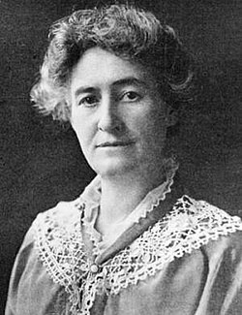
Reach out to your electeds
Learn. Respond. Engage.
Follow legislation
Engage in the interim.
Notes:
Education:
1. Girls graduate from high school.
2. Women can access and afford post-secondary or continuing education beyond high school.
3. Girls have access to opportunities outside of public school hours and curriculum, including afterschool, mentoring, and STEM programs.
Healthcare:
1.Women who can and want or need to work have the health and wellness to attain and keep employment.
2.Women and their babies and children have access to healthcare, including mental and reproductive healthcare.
Representation:
The gender of elected and appointed local and statewide leadership reflects that of the population.
Childcare and Workplace Policies:
1. Families have access to affordable and high-quality childcare.
2. Workplace policies offer flexible and realistic strategies for women, including moms, to work.
Income and Asset Development:
1. Women earn self-sufficient wages.
2. Women build assets over the course of their lifetime to ensure economic security in retirement.

Slide 5
Women's issues are important COMMUNITY issues.
Education
Healthcare
Representation
Childcare & Workplace Policies
Income & Asset Development
Notes:
Education:
1. Girls graduate from high school.
2. Women can access and afford post-secondary or continuing education beyond high school.
3. Girls have access to opportunities outside of public school hours and curriculum, including afterschool, mentoring, and STEM programs.
Healthcare:
1.Women who can and want or need to work have the health and wellness to attain and keep employment.
2.Women and their babies and children have access to healthcare, including mental and reproductive healthcare.
Representation:
The gender of elected and appointed local and statewide leadership reflects that of the population.
Childcare and Workplace Policies:
1. Families have access to affordable and high-quality childcare.
2. Workplace policies offer flexible and realistic strategies for women, including moms, to work.
Income and Asset Development:
1. Women earn self-sufficient wages.
2. Women build assets over the course of their lifetime to ensure economic security in retirement.

Slide 6
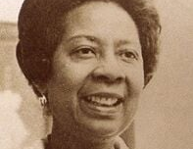
Bill Tracking at WYWF
(and then a trip to wyoleg.org)
Notes:
While it can be tricky to fully understand, if you can pay attention to individual budget items and offer support for those, they are like mini bills within a budget. For example the Child Development Center funding and the Wyoming Tomorrow’s Scholar in the Wyoming Community College budget ($20M) to fully fund the bill.
Highlight a few of the bills we’re watching and then use the link on our site to head over to wyoleg.gov

Slide 7
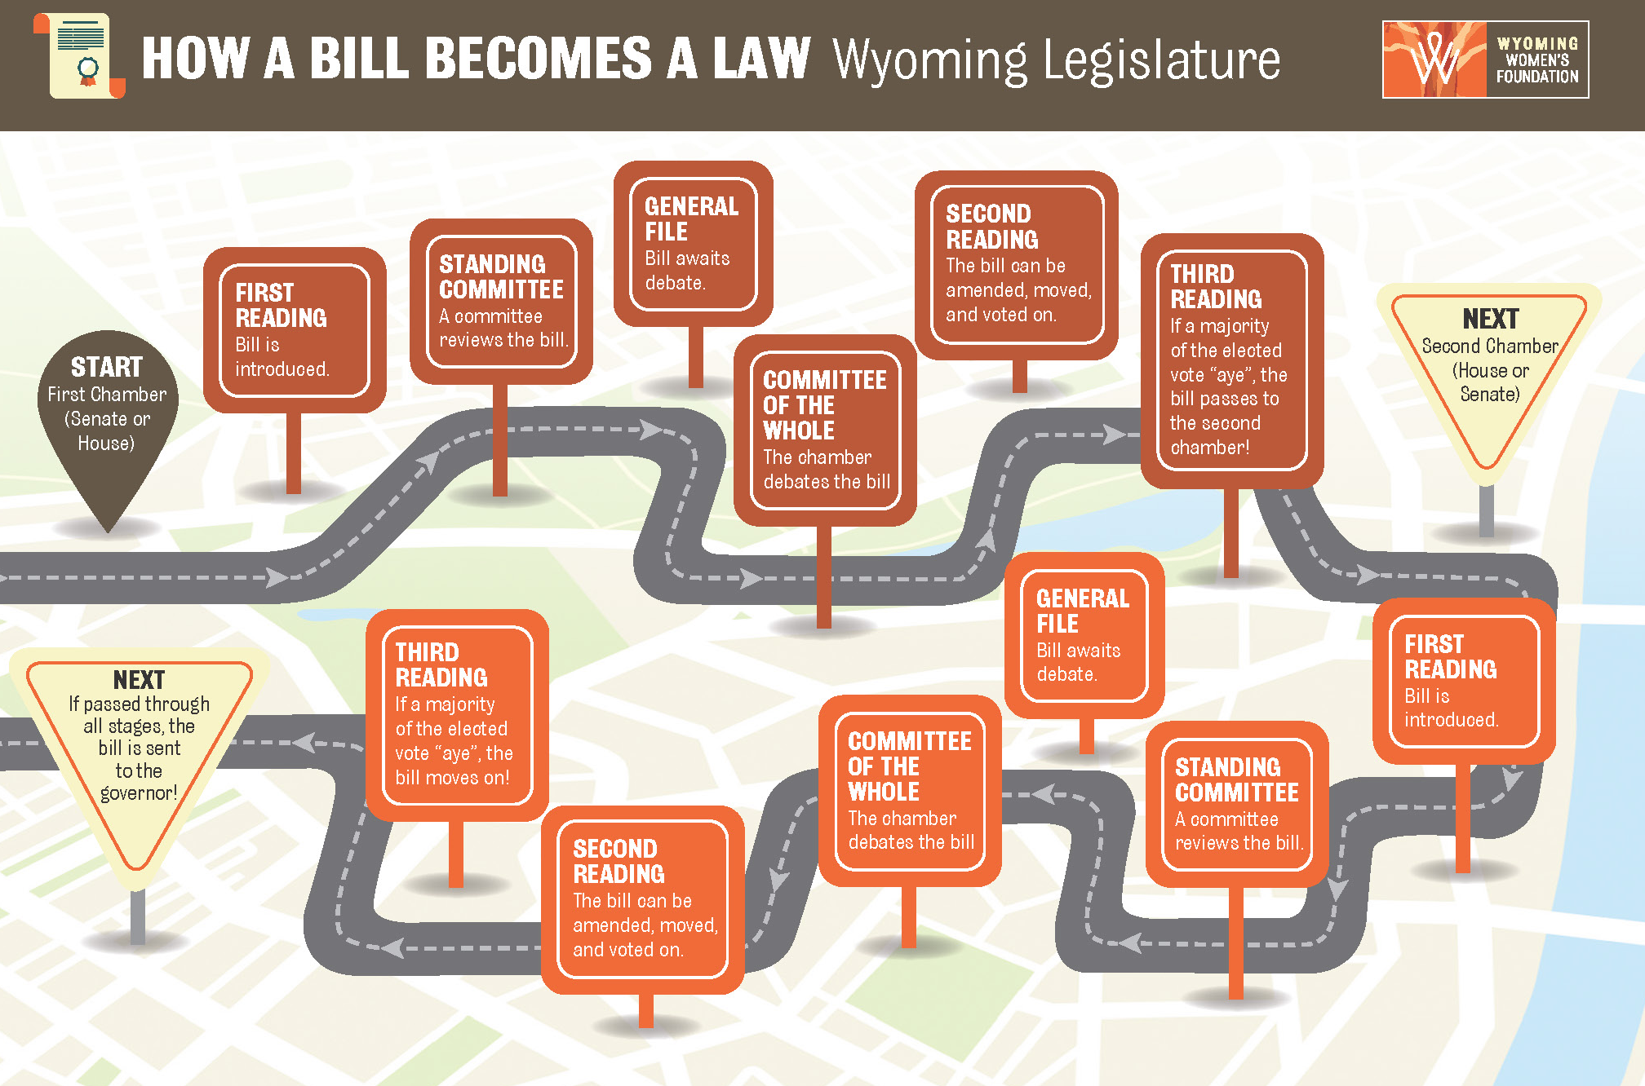
Ordered by floor leader
Public testimony
Moves to the other chamber
2/3 introduction vote during a budget session
Full body debates & votes
Notes:
This was sent in kit and it’s also on our website. This is a roadmap of how a bill becomes a law.
Bills can be drafted in committee or by a legislator or group of legislators. There are 12 parallel committees that are on both the house and senate side. If a committee comes up with ideas/solutions/recommendations, then the Legislative Service Office (LSO) drafts a bill for that committee. Bills can also be drafted by a legislator or group of legislators (often with help of LSO).
After drafted, the bill title is read allowed (introduced) in the chamber of origin by the majority leader in the house of origin. Generally the majority leader will introduce the committee bills first, as a block. Because it is a budget session, the bill or block of bills, must receive 2/3 votes to move forward (21 in the senate and 41 in the house). The majority leader will typically then read through all non-committee bills individually. it then gets referred to one of those 24 parallel standing committees – either on the house or senate side, house if originated in the house, senate if in the senate.
The committee can hear the bill and then pass, do not pass, or return to Committee as a Whole (COW) without recommendation. This is where the debate and discussion happens and where experts, agencies and the public can testify at the capitol or virtually. We encourage testimony!
Awaits General File which means it’s put on a waiting list and the majority floor leader gets to order the bill to be heard and will be heard by the committee as a whole (COW). The majority floor leader holds a lot of power in this position because there are many, many bills, and sometimes not enough time to hear them all. The majority floor leader can choose not to introduce a bill and allow time to run out.
Once the floor leader orders the bill, the full chamber (COW) can discuss the bill for the first time. This is important in terms of getting a sense of how the body is leaning on the bill. You can merssage lawmakers give legislators speaking points at this time – especially if you have research or additional information on the bill that hasn’t been heard.
Then second and third reading allow the bill to continue to be discussed, amended and voted on before heading to the other chamber. 3rd reading 2/3 must vote yes before it passes to the other ch

Slide 8
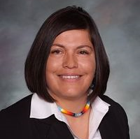
Is there a topic you care about?
How do you plan to get involved?
What is a reasonable step one?

Slide 9
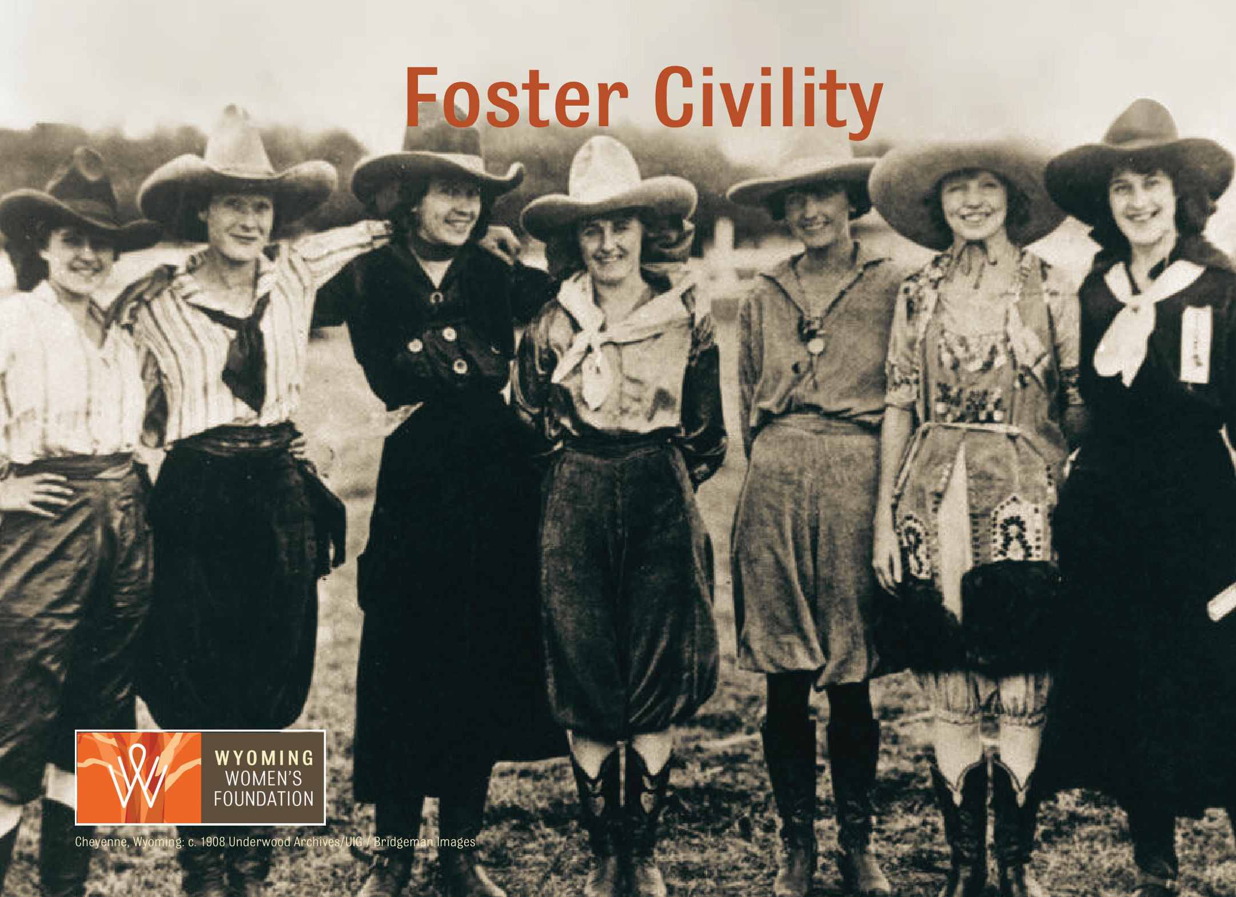
Notes:
I think that being civil and fostering civility can go a long way toward managing stress AND being kind is actually good for your heart health.
Talk to people the way you’d want those closest to you to be talked to.
Get to know the issues and your legislators
Practice legislative etiquette
Identify yourself as a constituent
Keep it short, relevant and personal
Offer appreciation
Be courteous and respectful

Slide 10

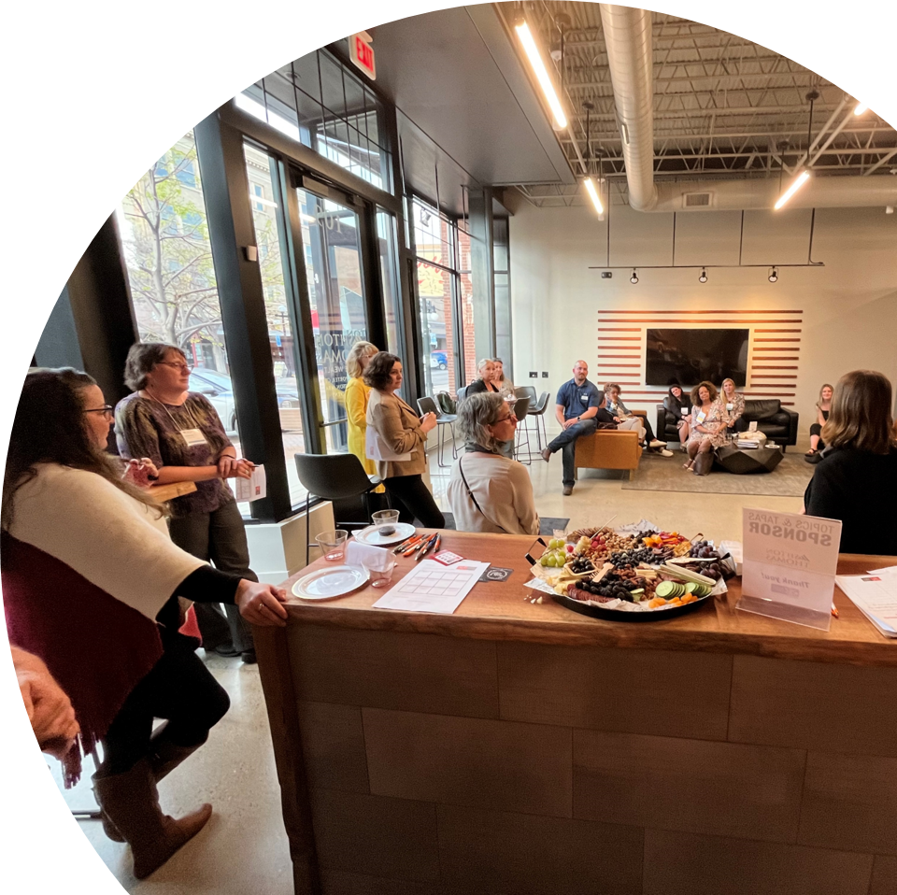
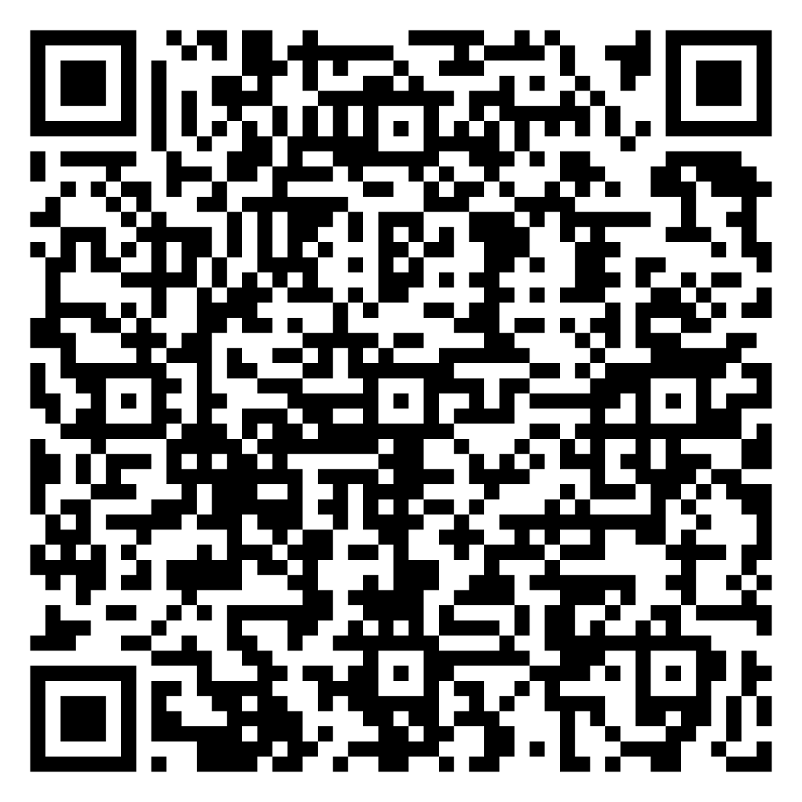
Become a Power Advocate!

Slide 11
Thank you!
Micah Richardson
micah@wycf.org
(307) 721-8300
www.wywf.org

